Slide 1
Hotel Management system
Submitted By
Md Junaeid Bhuyian 160104055
Afranul Haque 160104059
Nazmus Sakib 160104072
Md. Ruhul Amin 160104074

Slide 2

Project Motivation
Hotel management system is mainly a desktop based application. This project will be developed to maintain a hotel in a digitalized way.
Our main goal is to digitalize the analog system. Hopefully it will be able to reduce times and troubles of administrators of a hotel.

Slide 3

List of Primary Actors
Manager
Receptionist
Employee

Slide 4
List of Secondary Actors
System Service

Slide 5
Use cases according to the Primary Actors

Slide 6
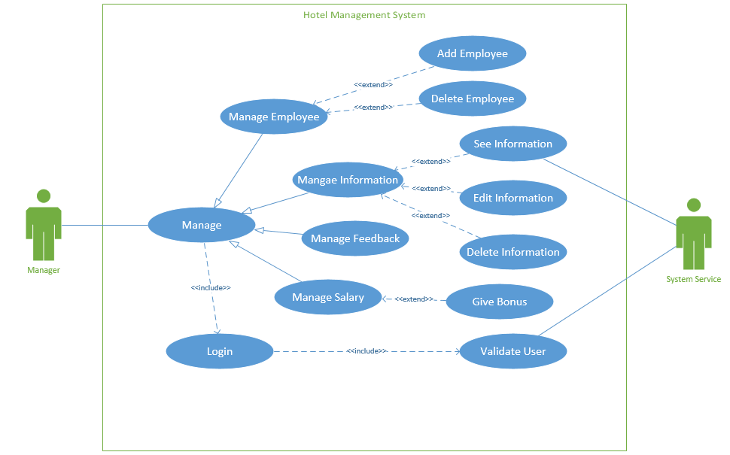
Use case diagram according to Manager

Slide 7
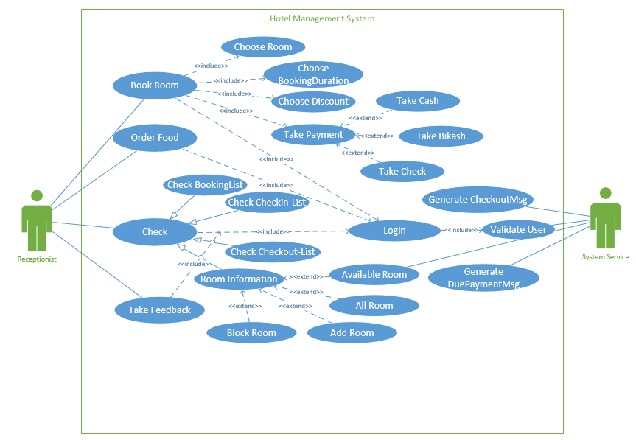
Use case diagram according to Receptionist

Slide 8
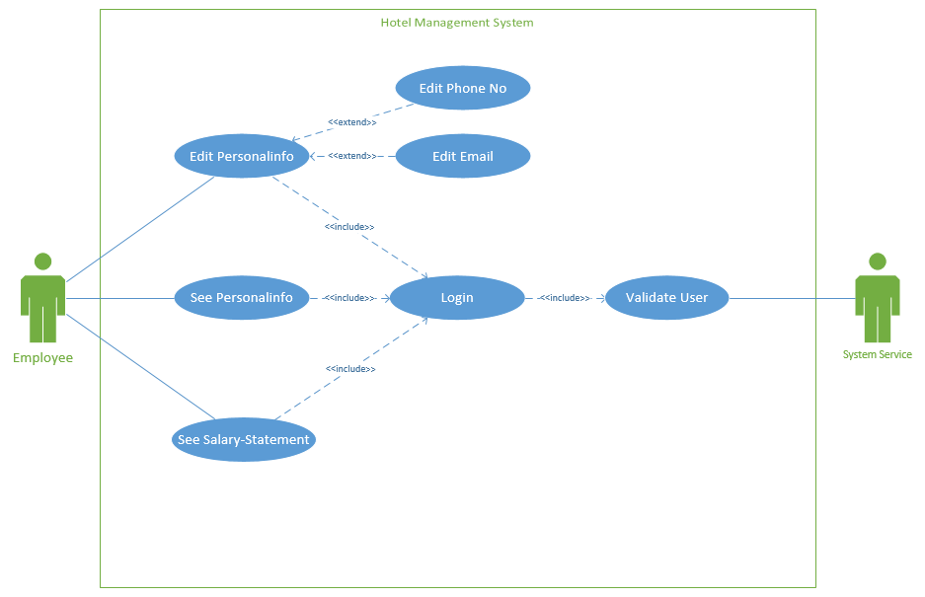
Use case diagram according to Employee

Slide 9
Class Diagram

Slide 10
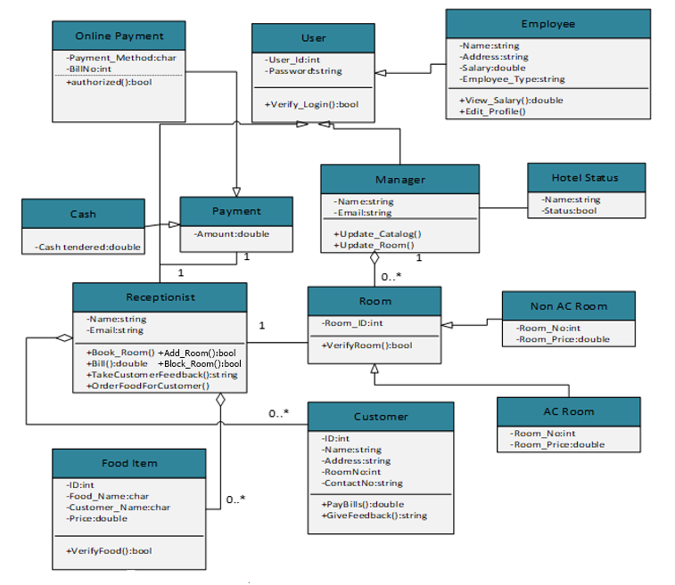
Class diagram of hotel management system

Slide 11
Thank You

